Slide 1
DEVELOP AN OUTCOME L2
Evidence of Learning Template
NSN: 0137393454
Tic-Tac-Toe Python Game
MILES MAKINO-TORRINGTON

Slide 2
Github /Drive link
Trello board or PM link
You MUST provide evidence showing how the problem has been decomposed, how the components have been developed and trialled, and of how they have been assembled and tested to create a final, working outcome.

Slide 3
Project management: Setup & Applied
Record evidence that you have setup project management tools to manage the development of your outcome.
Record evidence that you have chosen project management techniques to manage the development of your outcome.
Record evidence that you have setup/ chosen version control tools/techniques to manage the development of your outcome.
Explain why you believe that these tools and techniques are appropriate for the development of your outcome.
Record evidence that you have used your project management tools to manage the development of your outcome.
Record evidence that you have used your project management techniques to manage the development of your outcome.
Record evidence that you have used version control tools to manage the development of your outcome.

Slide 4
Google Calendar
I decided to use Google Calendar to plan my python project. I chose Google Calendar after a great deal of consideration, I looked into both Monday.com and Trello before deciding. But I decided against using these websites due to a variety of reasons, such as how both websites didn’t allow me to plan the exact times I wanted to work on my project. This was a very important factor in my decision as I thought it would be important to have a accurate schedule to manage my project to keep me on track with the pace I would like. As well as this there was also the fact that I had the most experience using Google Calendar over the other websites, this is due to the fact that I use Google Calendar to plan when to do my homework for school. Google Calendar also has a assortment of project management tools which help me manage my project better. For example I can set reminders so that I don’t forget that I planned to do my python project at certain times and keep on track. Also I can put descriptions on the times I plan to work to remind myself what parts of my project I want to have completed during the time frame. The way I used Google Calendar to plan was by creating a basic version of my schedule when I began to make the plan with the time frames and descriptions of what I wanted completed. At the end of each week I would assess if I was on track and if there was anything new that needed to be added to the Google Calendar for the next week so that the plan was accurate to what I wanted done and how much progress I had made so far. Overall, i’m happy with using Google Calendar to manage my python project as it helped me accurately plan my work so that i wouldn’t be too stressed or feel rushed.

Slide 5
Project management: Setup
Record evidence that you have setup project management tools to manage the development of your outcome.
I used Google Calendar to manage my plan the progress of my python project. I chose to use google calendar because it allows me to plan when I would do my code and my progress to see if I am on track with my planning or not. I was initially going to use Monday.com but I didn’t like how I couldn’t keep track of the time of day I wanted to have sections of my code done by.

Slide 6
Project management: Setup 2
Record evidence that you have chosen project management techniques to manage the development of your outcome.
The way I managed my project is by planning how much of my code I would do, which parts of my game I would code and on what day and time I wanted to have the code completed by.

Slide 7
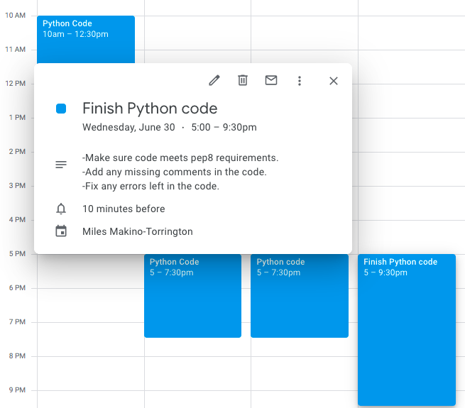
Week 10

Slide 8
Project management: Setup 3
Record evidence that you have setup/ chosen version control tools/techniques to manage the development of your outcome.
I took screenshots of the progress of my code whenever I had completed a section of my code and before and after I fixed an error or problem with the game/code.

Slide 9
Project management: Setup 4
Explain why you believe that these tools and techniques are appropriate for the development of your outcome.
I believe that these tools and techniques are appropriate as they worked very effectively to keep me on track with the progress of my game. It also helped me know which parts of the game I was missing or hadn’t completed yet.

Slide 10
Decomposing outcome
Record evidence that you have broken the outcome into smaller components.
Greeting
Marker Choice
Number to Marker Position
Win Check
Tie Check
Score
Play again
Trialling/Testing

Slide 11
Greeting and Marker Choice
Initially once the program starts it displays the line “Welcome to Tic-Tac-Toe!” this is done through a simple print function. The next line gives the player the choice to pick X or O as player 1’s marker. Player 2 is then automatically assigned the other marker. This is done by assigning either X or O to the Variable player1 and depending on the input the variable player2 would be either X or O. If X or O isn’t inputted the question would repeat itself.

Slide 12
Number to Board Position
The markers are placed on the board by first creating the list “Board” which holds 10 items the number items 2-10 determines the marker positions on the board. The def “player choice” gets the user to choose a position between 1 and 9 on the board. The number picked is the list item that is replaced by the users marker and then takes the position of that list item on the board.

Slide 13
Win check and Tie check
To check if there has been a win or a tie after every turn two defs are used “win check” and “full board check”. Win check checks every set of positions on the board that would be a win. This is done by checking the board list to see if the positions needed for a win are all the same and if it true then it’ll say whichever marker was last played won. The def “full board check” checks if the board list has any # left in it to see if there are still any places markers can be placed if there aren’t any the code breaks and asks if the user wants to play again.

Slide 14
Scoring
Scoring is determined by the def “scoring” this def makes a score list with two items these two items start at 0. If the win check is returned as true the marker increases the item on the list associated with the score for that marker. These scores are then displayed. The score is saved and added upon every time the game is replayed with the def “replay”.

Slide 15
Play Again
After the game is over the replay def is used, this def asks if the user wants to play again if replied with “y” the def will return true and continue the code which makes i = 1 again which returns the turn to the first turn. Marker choice is then used to let the player 1 pick the marker they want to use again and player 2 will have the other marker. Finally all the items are replaced with # like in the beginning of the program which clears all previous marker placements on the board.

Slide 16
Trialling components
Record evidence that you have trialled components. Show that you gathered information to inform your decision making.
Record evidence that you have trialled multiple components and have selected those most suitable.
Record evidence that you have used information from trialling appropriately to improve the functionality of the outcome.

Slide 17
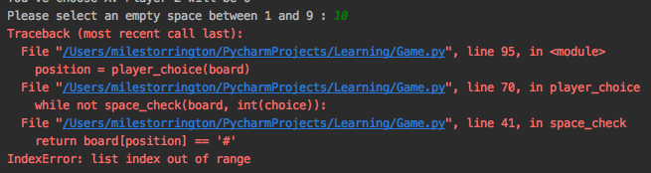
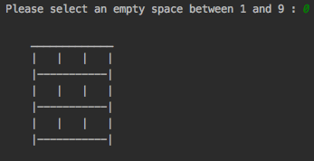
Trial 1:Errors with invalid integers
There were multiple errors that occurred with the board marker placement The first error was the fact that when the number 0 was inputted. This was due to the fact lists start with a the 0 item so it would continue the game but would have a blank game board. The second error was the fact that any numbers above 9 and below 1 as the items on the list used were from 0 to 9 so it would cause an error that ends the code. This error was fixed by making sure the input couldn’t be below 1 or above 9 and it would just repeat the input.

Slide 18
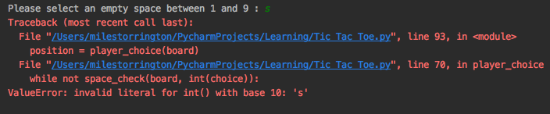
Trial 2: Error occuring with invalid string or float
There was another error that occurred with my board marker placement and this was the fact that if they entered a string or a float it would cause an error to occur ending the game. To amend this error I used a while loop with a try except statement. This was done by making the input a try statement and appending a except ValueError which would create a loop if a valid integer wasn’t inputted. This loop would be broken if a valid integer was inputted and continue normally.

Slide 19
Trial 3: Upper and Lower case errors
There was an error that occurred in two sections of my game. First was when picking the marker the input would require a uppercase X or O so the question would repeat if a lowercase x or o was inputted. This error also occurred in the play again question which needed a lowercase y or n to be inputted and if a uppercase Y or N was used it would repeat the question. These errors were fixed by using .upper() which made it so when a lowercase string is inputted it will be made into its uppercase form and .lower() which made it so when a uppercase string is inputted it will be made into its lowercase form.

Slide 20
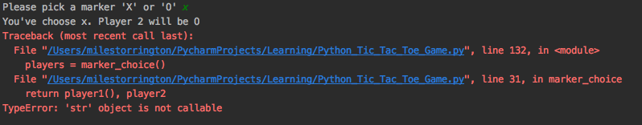
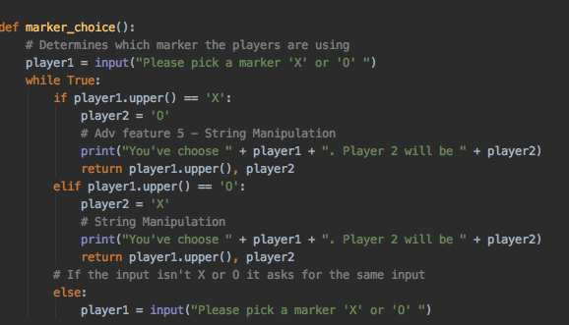
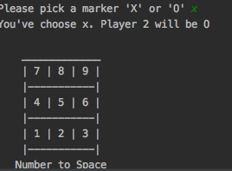
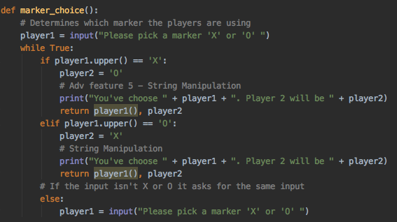
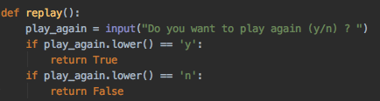
Trial 3 Screenshots:
Before Being Fixed:
After Being Fixed:

Slide 21

Trial 4: Replay ending with incorrect input
While searching through my code I discovered that there was an error with the def “replay” to play tic-tac-toe again. This error occurred when inputting any other input than y or n, it would cause the game to end even though it wasn’t supposed to. This was because any input other than y and n would also make the def false which would result in the code breaking. To fix this I made it so that any input other than y and n would repeat the input question and print “Please input a valid input.” this would repeat until a valid input was inputted.

Slide 22
Testing outcome
Record evidence that you have tested your outcome.
Explain how the testing made sure your outcome functions as intended to meet its purpose and requirements.
Record evidence that you have used information from testing appropriately to improve the functionality of the outcome.

Slide 23
Self-Testing
https://drive.google.com/file/d/1DBDnn6qeI4vUxGrV8hKAAvhShlvcFt7j/view?usp=sharing
As seen in the video everything in my program is functioning normally without error. Whenever a input that isn’t an option is used there is always a message explaining the error as well as repeating the question so that the user can then use a input the can be used.

Slide 24
Stakeholder Feedback
Example Board:
I showed my tic-tac-toe game Yiting in my english class. After testing out my game they said that I should put an example board displaying what number represents each position on the board. So that I wouldn’t have to explain where the positions when letting someone play it.
Example Board

Slide 25
Debugging
After initially completing my code and getting my game to function I began debugging my code. Doing this was extremely useful as it got rid of all errors which would improve the experience of any users as they wouldn’t run into any bugs while playing the game. For example I had many problems with my inputs with errors occurring when incorrect inputs were inputted. I fixed this using a try function and appending a except ValueError to stop any incorrect inputs to end the code.

Slide 26
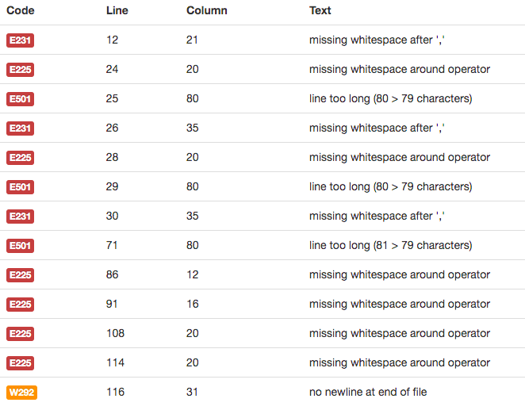
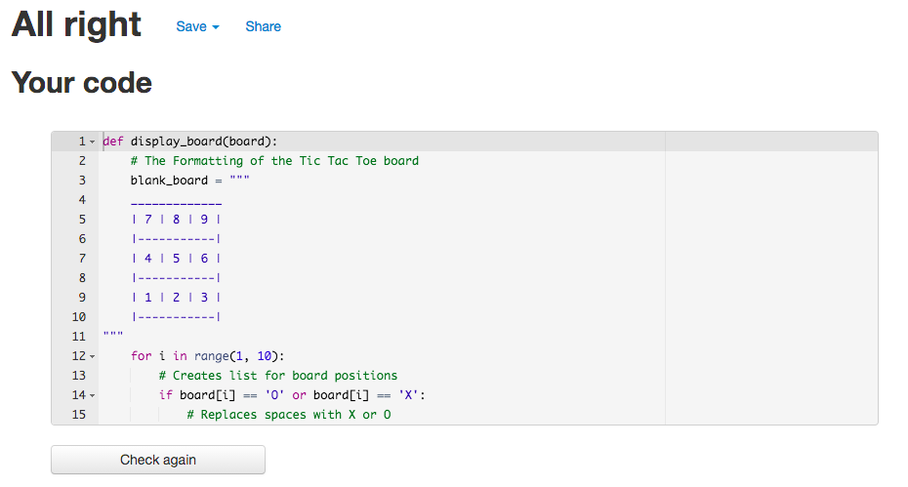
PEP8 Check
After completing all my trialing and other testing I tested my code I checked my code on PEP8. The errors consisted of missing whitespace after commas and around operators. Also there were some line which are over 79 characters which isn’t allowed as it might cause errors.
PEP8 check before fixing
PEP8 after fixing

Slide 27
Version Control
Your version control evidence should go here. This could be in the form of annotated screenshots which show you you managed this process or you could make a brief screencast explaining how you implemented version control.

Slide 28
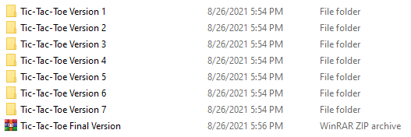
Version Control
As I progressed through making my game I periodically saved versions of my code. I would do this after adding a large amount of code or before I made big changes to my code. I did this to have a backup of my code in case some error occurred and I lost the current version of my code that I wouldn’t lose a significant amount of my work.

Slide 29
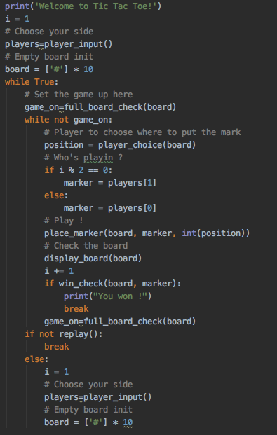
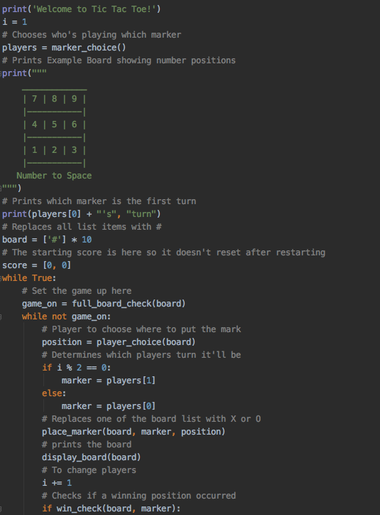
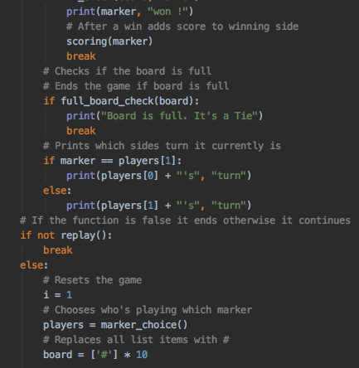
Version Control Screenshots
After initial completion:
Final Version:

Slide 30
Relevant Implications
Explain the relevant implications here. Please watch this video to learn how to do this.
Explain the Implications that are relevant to your outcome.
Record evidence that you have addressed the Implications that are relevant to your outcome.

Slide 31
Functionality
Functionality is what was done to make sure the program functions as intended. Such as if errors appear in the code, has features the user wants and if the program functions on all kinds of devices.
I strongly believe that my code addresses this relevant implication as the errors I found after thoroughly testing and trialling my code were all fixed. I also did Stakeholder feedback which let me know what users want in my program and I added these into my game. The program also functions on a large majority of fairly old devices as my game is text base so it doesn’t require a powerful device to play.

Slide 32
Sustainability and Future-Proofing
Sustainability is how a program is made so that it can continue to function as software and technology improves in the future. Future-proofing is designing your program so that it can be changed and updated by others in the future as well as.
While making my digital outcome I made it while taking into account this implication. I did this by making it easy for future programers to be able to make changes and add on to my code. This was done by adding comments explaining the purpose of what each section of the code did for the program. As well as this there are previous versions of my code for reference on the progress of how the code was constructed. My code also consists of a great deal of def functions so the code is neatly organized and easy to tell what each def’s purpose is.

Slide 33
End-User Considerations
End-User Considerations is making your digital outcome while making sure that the outcome won’t be too difficult for users. This implication is important so that any user will be able to use your digital outcome.
I constructed my digital outcome while making sure that any user wouldn’t be confused. I did this by making sure that all parts of the program were intuitive and any errors that would occur would be explained and the question would repeat itself. As well as this any concepts that may be confusing I made sure to add a example such as the way the board is layed out, I added a example board to show how it worked.

Slide 34
Usability
Usability is making the digital outcome thinking about what the users will need to do and how to help them do this. These would make it easier for the user to use the digital outcome.
As I was trialling and testing my program I thought about this implication a great deal. I implemented usability by thoroughly trialling my program to make sure there wouldn’t be any errors that would occur that would damper the experience for the user or even end the program entirely. Also I got stakeholder feedback while testing my program asking many different people to test my program and give feedback on what I should change to improve other users experiences.

Slide 35
Evaluate
Discuss how the information from planning, testing and trialling of components assisted in the development of a high-quality outcome.

Slide 36
Evaluate - Planning
I used Google Calendar to plan my digital outcome. At the end of each week I would plan for the next week so that the planning would be accurate to what I needed to be done. Using Google Calendar was very useful as it allowed me to accurately plan specific time frames (What hours I would work each day) I wanted specific parts of my project to be completed during. Doing this allowed me to stay on track throughout the entirety of creating my digital outcome and complete it without any issues with time.

Slide 37
Evaluate - Trialling
While and after constructing my digital outcome, I made sure to trial all the functions and features in my program to make sure they were no errors and that they were at a level that users would be happy with. I did this by thoroughly checking my functions and features to see if they needed improvement or they weren’t functioning properly. I fixed these problems to the best of my ability by using my previous knowledge of python as well as researching how to fix them online. Trialling was extremely helpful as it made it so my final digital outcome was very refined and greatly improved my program overall.

Slide 38
Evaluate - Testing
After I initially completed my digital outcome I began testing my program. I had to do a large amount of testing as there were many problems and improvements I found out that I had to make to my code. Bug testing was very vital in my testing with it finding many errors that could have really dampered any users experiences if they weren’t fixed. As well as this I also got some classmates to test my game and ask them for any feedback and recommendations. This was useful as it gave me a different perspective and let me improve the game for other users. Finally, I used a PEP8 checker to make sure that my code was meeting PEP8 requirements to make sure nothing in my code would go wrong. Testing was very important in making my project polished and refined to meet the expectations of users.

